Slide 1
Paper details
Author name: KH Teoh.
Paper name: Face Recognition and Identification using Deep Learning Approach.
Paper Link: https://iopscience.iop.org/article/10.1088/1742-6596/1755/1/012006/pdf
Publisher name: IOP Publishing.
Year of publication: 2021.
Paper Architecture:
[CONV – POOL – CONV – POOL- CONV – DROPOUT – FLATTEN-FC ]

Slide 2
Dataset
Link: https://drive.google.com/drive/folders/1rstwEZaGsu162AWpZCKRGqhOOZo_0NgW
Number of samples:1500
Classes number: 5
Classes labels: [“Ahmed Amr” , ”Mohamed labib” , “Bebo” , ”Mohamed Mokhtar” , ”Hossam Ali”]
The dimension of images: 3

Slide 3
Implementation details
Number of training data: 1125 (75%)
Number of test data: 375 (25%)
Hyper-parameters
initial learning rate = 0.001
optimizer = adam
regularization = dropout
batch size =32
Number of epochs = 15

Slide 4


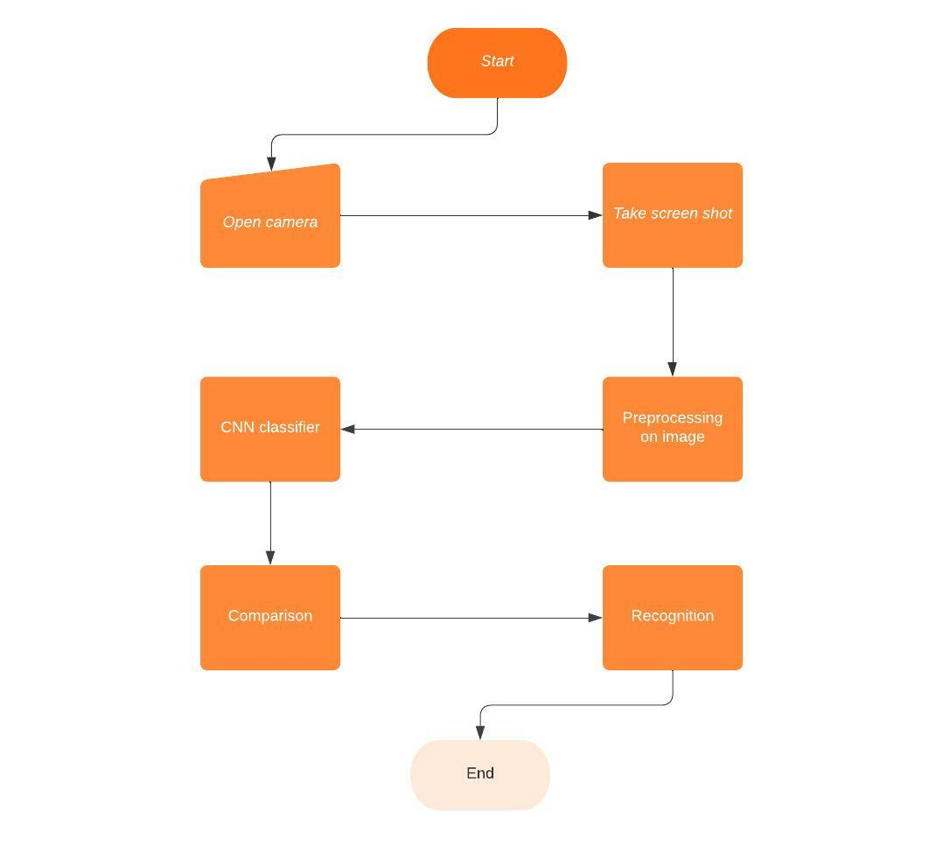
Block diagram

Slide 5
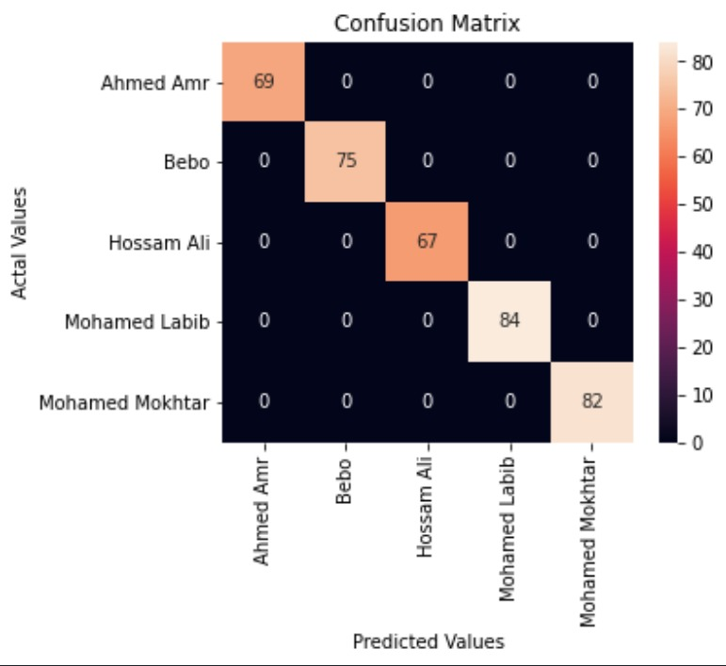
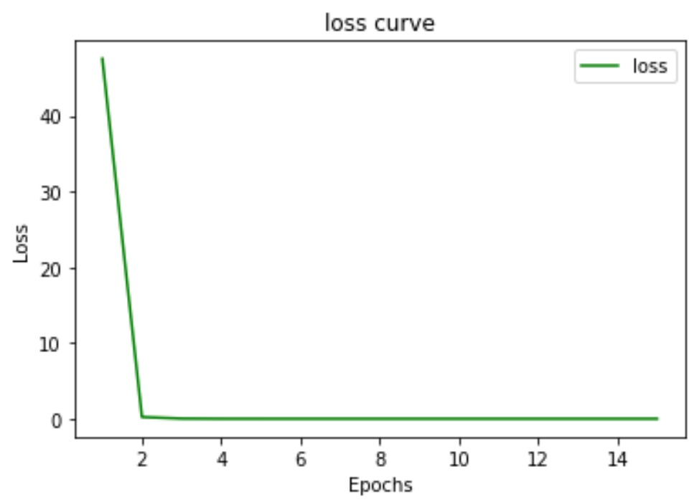
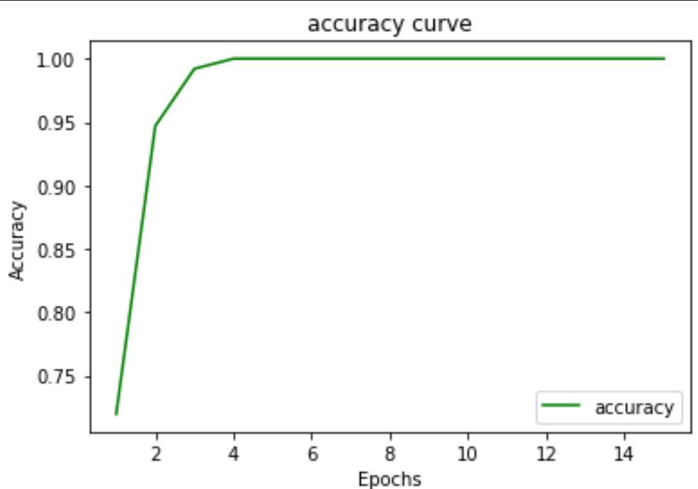
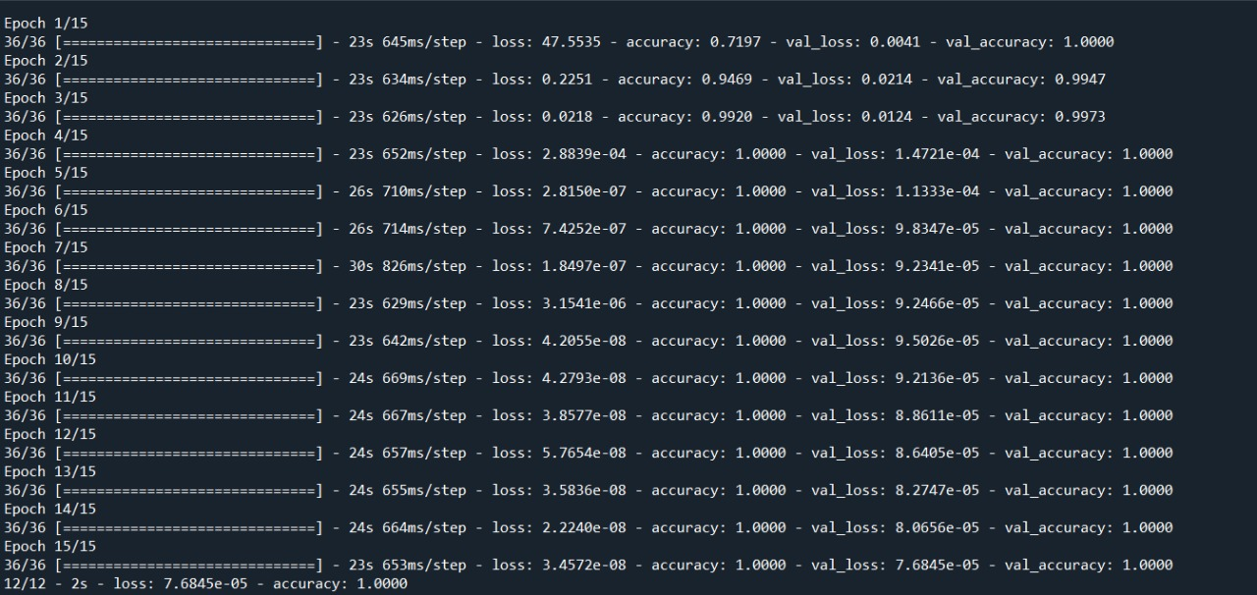
Result and visualization

